Slide 1

Welcome
Edgemont Community Association
Virtual Disc Golf Webinar
Wednesday, July 7th 2021
Please be aware that this virtual meeting will be recorded.
Notes:
People sign in, Bill advises people that the only folks talking will be presenters so please turn off audio, and ask questions via chat.

Slide 2
Hosts
Presenter: Brett Plaizier
Moderator: Rick Wierzbicki
Committee members will provide additional support as required

Slide 3
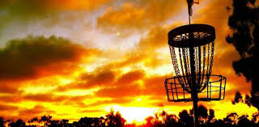
Edgemont Disc Golf Webinar
July 7, 2021
Presented by: Edgemont Disc Golf Committee

Slide 4
Agenda
Introduction
Committee Members
Sport Programs in Edgemont
Public Engagement
Introduction to Disc Golf
Initial and Final Course layout
Signage Possibilities
Budget and Funding
Timeline
FAQ’s
Notes:
The meeting is called to order by Bill

Slide 5
Committee Members
Rick Wierzbicki – Chair
Brett Plaizier – Previous chair, project creator, board volunteer, finishing project despite move to BC
James Koizumi – Expert Calgary Disc Golf committee member
Matt Sticksl – Edgemont Resident
Stephanie Luk – Edgemont Resident
Bruce James – Edgemont Resident

Slide 6
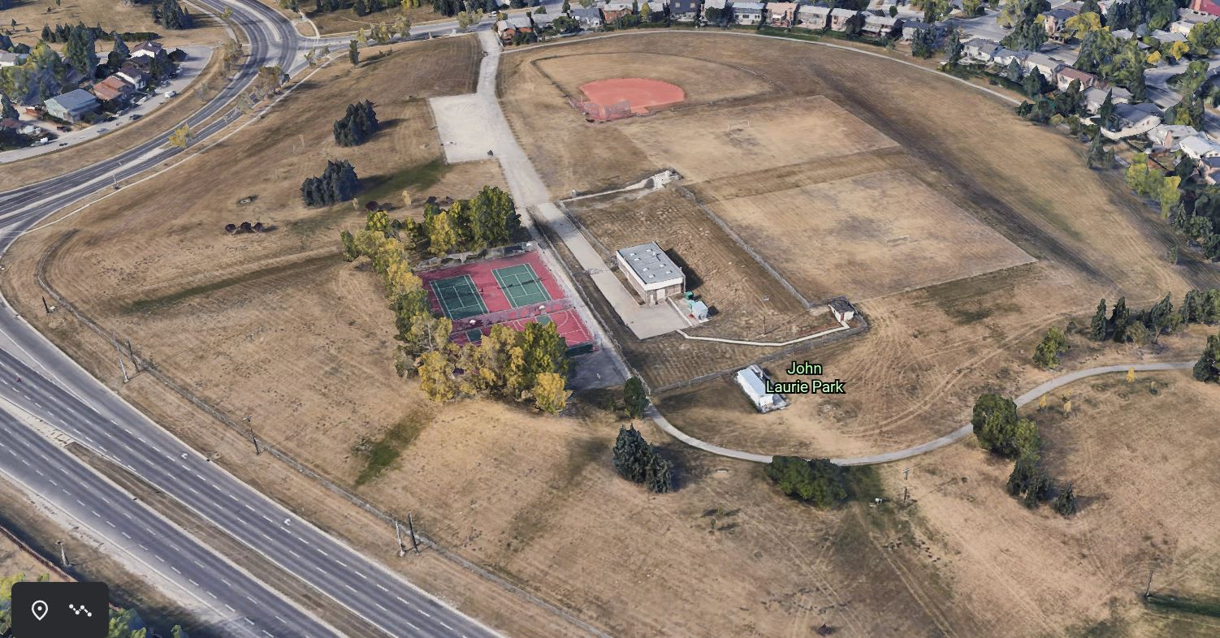
Location

Slide 7
Sport Amenities In Edgemont
As part of the results of the community survey of 2018 there was recognized a desire for additional recreational opportunities within the community, disc golf and pickleball were suggested as top choices
Disc golf was identified as a family friendly sport that was growing in popularity and was low cost to install and maintain and required minimal investment to participate in
During the Covid pandemic the need for recreational opportunities that could be played in a safe manner outdoors near our homes was reinforced
The Disc Golf trial course was well used and appreciated by a broad group of Edgemont and City residents

Slide 8
Public Engagement and Mitigation
Engagement with the community has been ongoing since the project was approved as a temporary test course in 2019
Permission was obtained from the city for installation of signage and basic stakes to mark course layout
Community input was sought via newsletter articles, annual reports at ECA AGM meetings, and direct calls for input placed on the sign at site
Walk throughs on site were held and virtual meetings were held with interested residents
The course was extensively modified and improved via public input

Slide 9
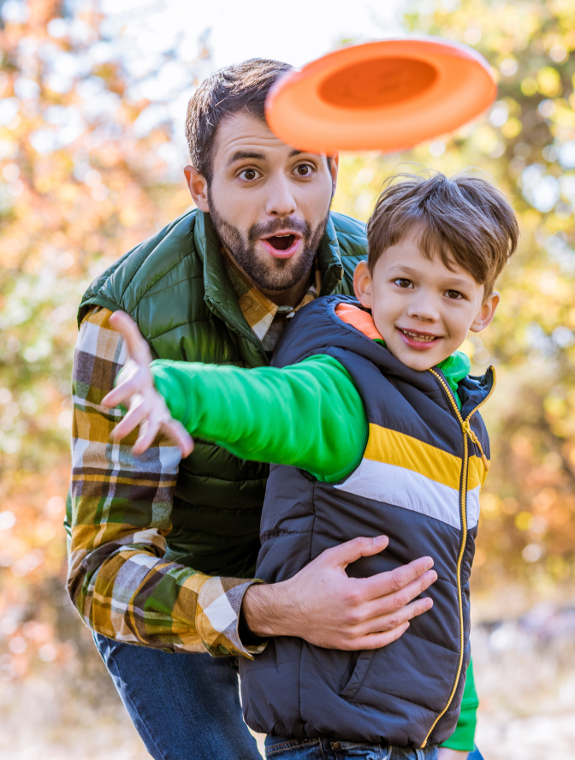
Introduction to Disc Golf
Fast growing sport, popular amongst all ages
Fun family oriented sport
Low maintenance, inexpensive activity (free to play after installation)
Easy to learn, rules similar to golf
Physical and mental health benefits
Opportunity to be part of disc golf community and participate in recreational leagues
Getting outside!

Slide 10
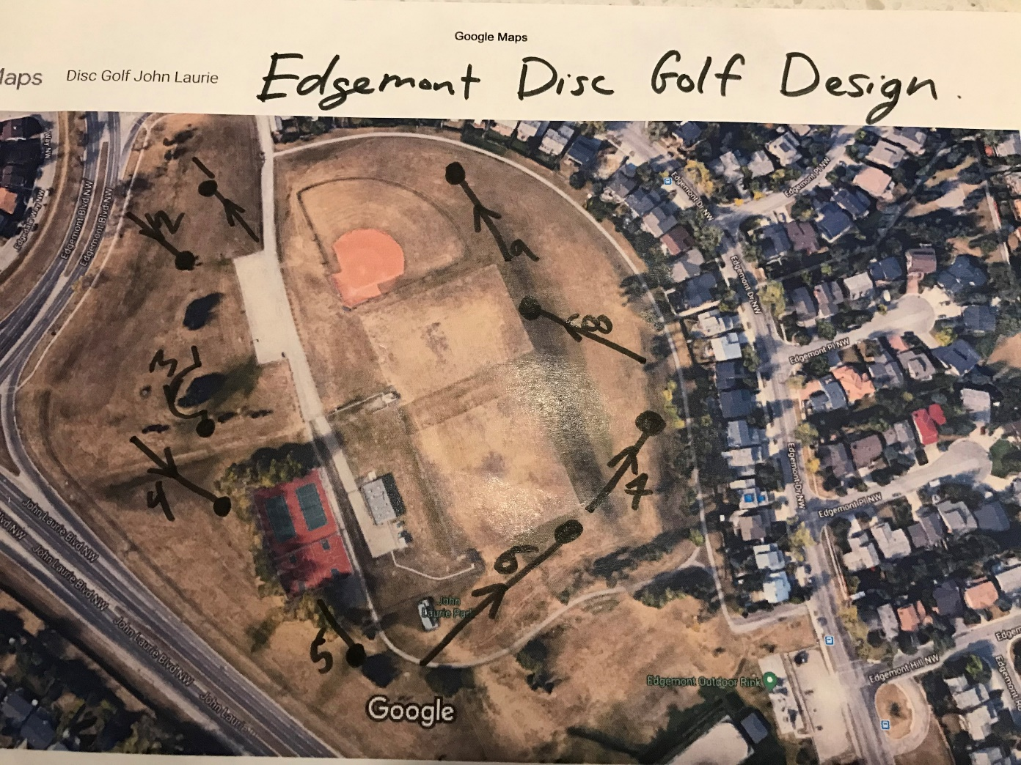
Initial layout
First layout had holes near homes, these were removed and the course was moved to the slopes away from existing fields

Slide 11


Final Course Layout – 11 hole
Unique layout with slopes
Local, Community Access
Beautiful Scenery
Location: John Laurie Park – Slopes west of parking lot

Slide 12
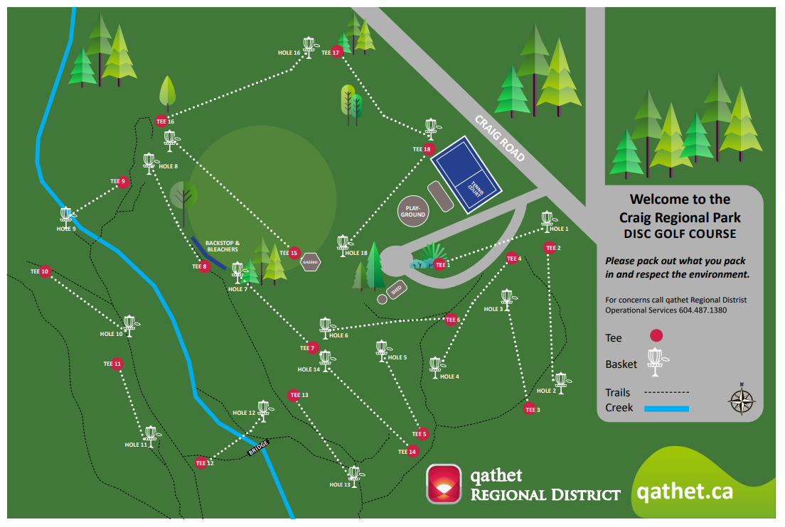
Signage Example: Main Sign

Slide 13
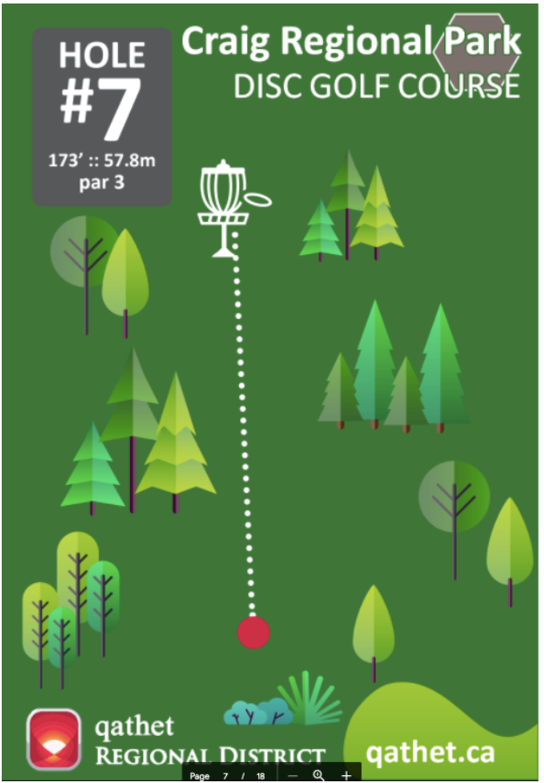
Hole Sign Example

Slide 14
Project Plan
John Laurie Park selected as best site in community
Existing infrastructure, undeveloped slopes with great mountain and city views
Course designed, modified to meet community needs
Funding for majority of course development gained
Webinar completes community engagement
Final survey to collect input from residents
Board decides on approval or more mitigation
Construction to follow

Slide 15
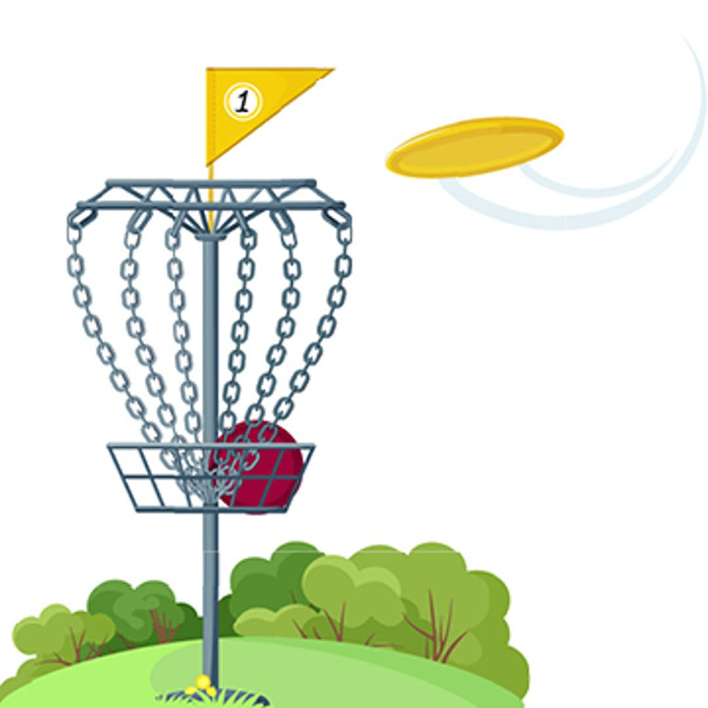

Timeline
May 2018
Disc Golf proposed for the community of Edgemont
July 7, 2021
Community Webinar
June 26, 2021
Intro to Disc Golf Event
June 2019
City of Calgary Parks and Disc Golf Association Input
July 2019
1st post on Edgemont Community Newsletter
July 10, 2021
Public Engagement Survey
PHASE 1: PLANNING AND PREPARATION
July 14 2021
Purchase Baskets
August 2021
Receive Final Approval from City Parks
September 2021
Baskets and Signage Installed
May/June 2022
Tee pad Installation
June 2022
EDGEMONT DISC GOLF COURSE COMPLETE!
PHASE 2: CONSTRUCTION
Note: Course is always opened to public for play (before, during or after baskets and signage have been installed.

Slide 16
Budget and Funding
ITEM | COST
Signage | $4000
Basket Cost | $6500
2021 Install (Basket and Signage) | $8000
2022 Install (Tee Pads) | $9000
Funding:
Calgary Foundation (spend by Dec 2021 | $7500
Parks Foundation | $10000
OVERALL COST BY ECA: | $10000

Slide 17
FAQs
John Laurie Park is not an under-utilized park. Will the disc golf interfere with the other sports and sport fields
  (DGC Response): Green space is of value to Calgary and the community of Edgemont. Taken into consideration of the numerous activities currently at the John Laurie Park, the Disc Golf Committee has taken the initiative to locate the course to the west side of the parking lot on the slopes which are not used for sport, there is no interference with the sport fields.

Slide 18
FAQs
Will users of the disc golf course interfere with the sport fields
  (DGC Response): Disc golf players will be advised to respect other users of the park and to not walk through a practise or game on the adjacent fields or throw discs at or near players. Respect for other users of the park is a requirement of disc golf course users.
  The committee has moved the Hole 11 basket further downslope, from the new basket location it is much more attractive to walk back to the path to return to the parking lot than cut across the field. Signage will direct players to use the path instead of cutting across the fields if they are being used

Slide 19
FAQs
The Practice Basket must be moved off the playing fields.
  (DGC Response): The practice basket location has been moved to the west of the parking lot. Hole 1 is moved slightly to the west and the practice basket is moved to the proposed location on the same side of the course.

Slide 20
FAQs
Holes 1, 2 and 3 need to be revisited to minimize interference with the public pathways/bus shelter.
  (DGC Response): Interference with public pathways/bus shelters have been considered. Hole 1 is moved west to minimize chances of discs flying to public pathways and major roads. Hole 2 and 3 tee-off currently utilizes existing pathway, location will be clearly signed and within line of sight for pedestrians. During the course of play throughout the following year, DGC will take feedback to consider the need to add a dedicated tee-off pad away from the pathway.

Slide 21
FAQs
Is there sufficient time to develop the course this year, is the decision to build the course already made?
  (DGC Response): Yes there is time. Consultation with the larger Edgemont Community has been ongoing since 2018. A webinar will be held with a follow up survey to quantify the Edgemont Community engagement and gather further information in early July. The ECA board will take the recommendation of the committee and the City of Calgary parks department and approve development, if merited, once that information is collected.
  Once approved we anticipate having materials and being able to construct in September

Slide 22
FAQs
Is the project being rushed? Can this process be slowed down, incorporating the restrictions of the funding that is already in place?
  (DGC Response): The Edgemont Disc Golf is planned to be constructed over 2 years. In the summer or fall of 2021 the plan is to install permanent baskets based on feedback and trial over the past year. The plan for the summer or fall of 2022 is to install required launch pads based on observing patterns of use from a season of play.
  Planning started in 2019 and there has been ample time to come to the final course design which has incorporated and mitigated the concerns of residents and users. The committee believes a high quality layout has been developed, thanks in no small part to strong input from residents, and we have a top notch, entry level, family oriented course which will serve the residents of the community for years to come.
  One grant of $7500 must be spent in 2021.

Slide 23
FAQs
Is the project being phased, can T pad installation be delayed.
  (DGC Response): The project construction is being phased after two years of planning. Launch pad design and locations will be a continued investigation through the course of 2021/2022, construction of the pad phase is planned for 2022.

Slide 24
FAQs
Will the development of the project increase local traffic, will there be more garbage, will there be more frequent garbage pickup?
  (DGC Response): Traffic access to the parking lot is via a major road and a driveway before homes are encountered. Disc golf is not expected to add a great deal more traffic which can enter and exit without impacting the community.
  DGC will add an extra bin to address the litter issue. This is an existing concern and the addition of another bin should improve the situation. A call to 311 has resulted in more frequent emptying of the garbage bin.
  The signage for disc golf players will include a request to not litter and pick up while they play through. This has been very effective at other Disc Golf venues.

Slide 25
FAQs
The maintenance of the disc golf course, once installed, becomes a City asset and the City helps with the maintenance.
  (DGC Response): The course will become a sporting asset of the City Park and ELM which is doing maintenance right now will continue to do maintenance in the future.
  The ELM budget is not only from the lot levy on residents of Edgemont, ELM also receive an annual grant from the city which covers what the city would have spent on park maintenance.
  ELM picks up litter but garbage collection is done by a city hired contractor.
  ELM does not expect that the disk golf course will have a noticeable impact on park maintenance, ELM already does a weekly mowing throughout the growing season on the slopes on which the course is planned, extra mowing will not be required. ELM mows a quarter section of grass and trims around hundreds of items each week, trimming around 12 additional posts will not be noticeable.

Slide 26
FAQs
Can we be assured that any liability claims in case of accidents will be covered by the City of Calgary
  (DGC Response): DGC and the City of Calgary Parks has spent much effort to design a course that is safe and conforms to the City requirements. It is our understanding that the City would take on liability when it is a city asset, just like it does for the park, the tennis courts, and the existing fields.

Slide 27
FAQs
The budget set for the project is $27,500 with $17,500 already raised through grants. Is the budget realistic?
  (DGC Response): Yes the budget is realistic. The two groups who granted us $17,500 reviewed and approved our budget as part of their evaluation. The budget has also reviewed by the ECA board and approved.
  Since we won’t be pouring concrete pads for all of the holes (the current budget had planned for this) the budget will drop significantly (each tee pad was budgeted at $1500 a piece). As this will be a great asset to add to the community any costs not covered by grants and donations will be covered from ECA reserves,
  This is a simple project with only modest construction, the drilling of 12 holes in the ground and cementing in of 12 posts is unlikely to lead to construction overruns.

Slide 28
Other FAQs
Q: Who is the target audience for the Edgemont Disc Golf course?
A: Edgemont residents are our target audience, but the course is open to everyone as it is in a public park. The course targets beginner to intermediate level players. It is intended to be an introductory, family friendly course. Although short, the course layout has unique elevations and tree lines that provides challenges to the more skillful players.
Q: How does the Edgemont disc golf course affect existing pedestrian pathways and playing fields?
A: Course was designed to have no impact to sports playing fields at the John Laurie Park, and have minimum impact to pedestrian pathways. Where applicable, low traffic pathways are used as tee off pad to minimize overall cost.

Slide 29
Community Letters of Support
The community association has received many letters of support from community residents and from disc golf enthusiasts from elsewhere in the city for this development on a city park.
The survey of 2018 which was completed by 520 residents identified the need for more outdoor sport facilities in the community, disc golf was identified as preferred amenity, (report of Jane Coates to the ECA board and AGM, 2018)
Residents are pleased with a course that offers an opportunity for unstructured play for the entire family

Slide 30
Edgemont Youth Challenge 2021
https://drive.google.com/file/d/1Ijht7cAKFLzpYSkOIbNp-9duOhC4sxpx/view?fbclid=IwAR0bI0z74SUTL1Hazs2GZVfwubwRUFwQ7jYchUzDMQQKiu82DalaH_fThw0

Slide 31
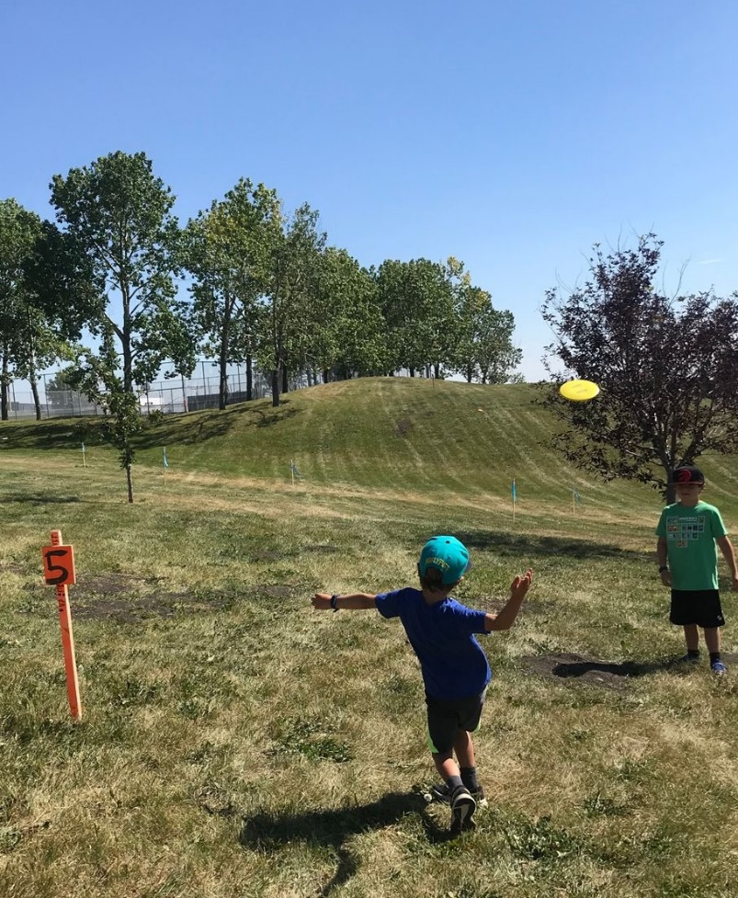
Thank You
Follow up Survey
Please take the community disc golf survey to provide additional information to the ECA board
Questions?
Email discgolf@edgemont.ab.ca and you will be sent a link to the survey

Slide 32
Feedback?
Thank you for joining us this evening.
We appreciate your time and your feedback. For comments, email
discgolf@edgemont.ab.ca
Notes:
Bill adjourns the meeting and thanks everyone for coming out.

Slide 33
A Word From Our Sponser
Casino
August 11th and 12th
Elbow River Casino
Volunteers Needed
Casino@edgemont.ab.ca
Volunteers@edgemont.ab.ca

